Slide 1

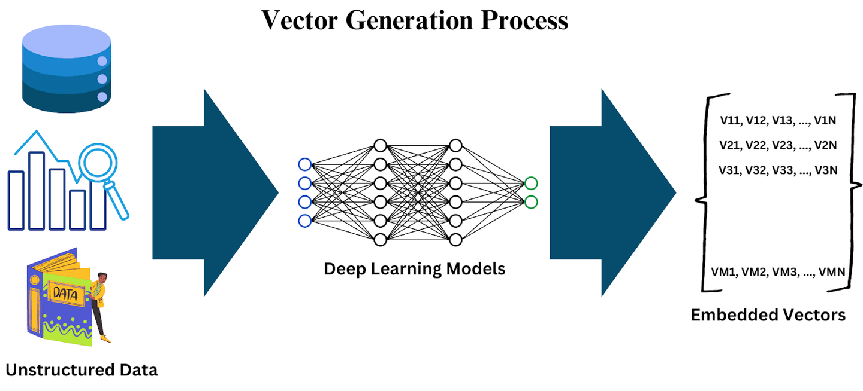
Unstructured Data Processing

Slide 2


Mohamed Rady Salah

Slide 3
Key Objectives
Session 1: Text Pre-Processing
Regular Expressions
Tokenization
Removing Stop Words
Stemming and Lemmatization
Text Representation
• Part of Speech (POS) Tagging

Slide 4
Key Objectives
Session 2: Image Pre-processing
What is a Digital Image?
Basic Image Operations
Convolution 2D (Conv2D)
Edge Detection
Image Segmentation

Slide 5
Session 1: Text Pre-Processing
Regular Expressions

Slide 6
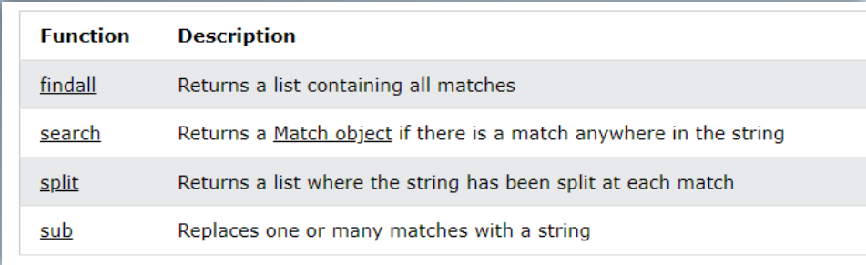
Regular Expressions
• A regular expression is a sequence of characters that specifies a search pattern in text
•

Slide 7
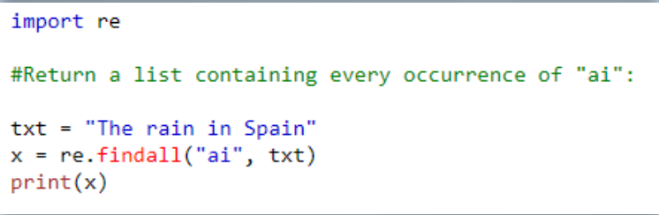
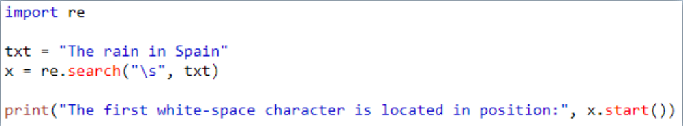
Regular Expressions
• Use Cases for Regex: – Parsing documents with expected component structure – e.g. remove certain sections from emails – Validating User Input: e.g. does email match xxx@xxx.com?

Slide 8
Session 1: Text Pre-Processing
Tokenization

Slide 9
Tokenization
Tokenization is a key (and mandatory) aspect of working with text data.
Splitting raw text into small units (tokens)for processing:
– Words
– Sentences
– N-grams

Slide 10
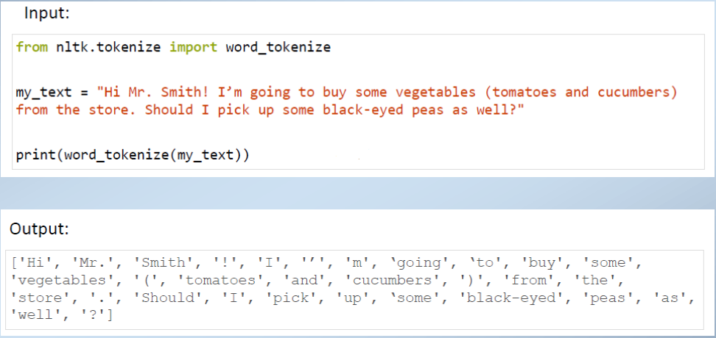
Tokenization

Slide 11
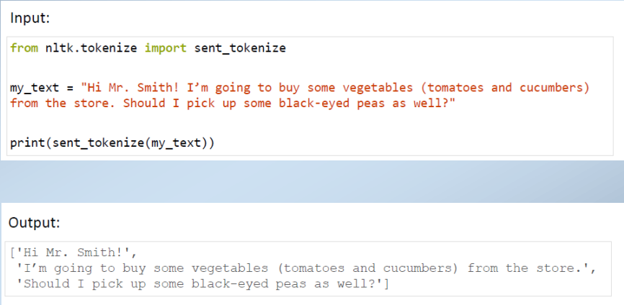
Tokenization

Slide 12
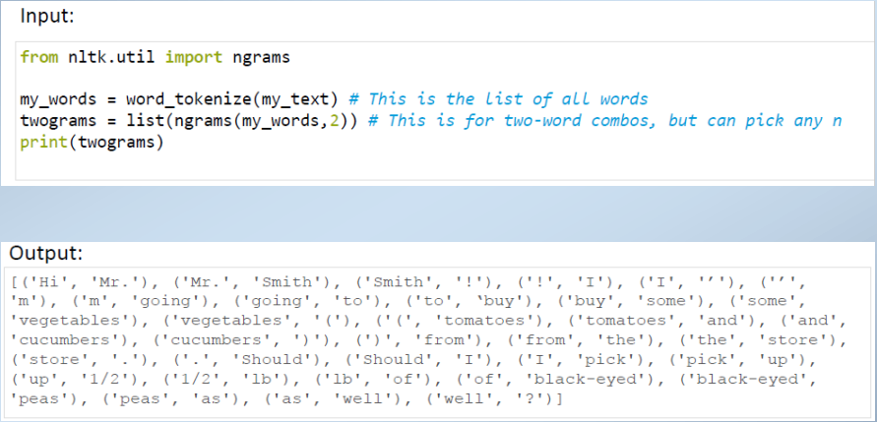
Tokenization

Slide 13
Session 1: Text Pre-Processing
Removing Stop Words

Slide 14
Removing Stop Words
Stop word removal is one of the most used preprocessing steps across different NLP applications.
The idea is simply removing the words that occur commonly

Slide 15
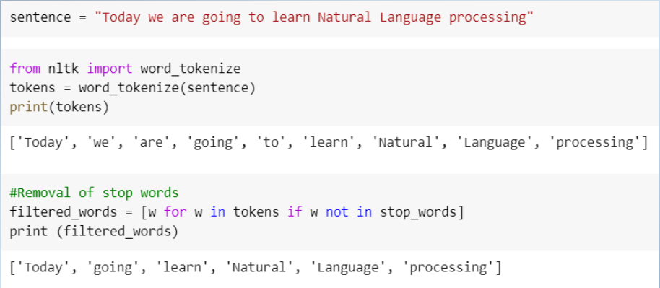
Removing Stop Words

Slide 16
Session 1: Text Pre-Processing
Stemming and Lemmatization

Slide 17
Stemming and Lemmatization
Stemming is a process whereby text is stripped off any affixes(suffixes).
• Stemming works by chopping off the ends of words to convert them to their stem or root.
The idea is simply removing the words that occur commonly
The lemmatization process also strips words of any affixes except that the resulting stem/root returned is always a dictionary word (from corpus)
. • Lemmatization doesn't just chop off the endings of inflected words.

Slide 18
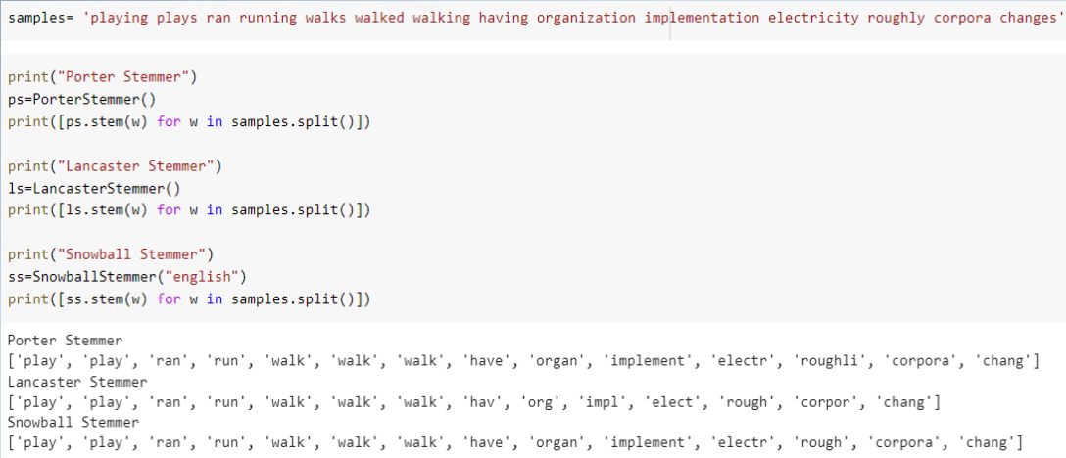
Stemming and Lemmatization

Slide 19
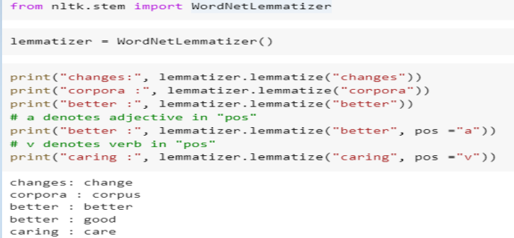
Stemming and Lemmatization

Slide 20
Session 1: Text Pre-Processing
POS Tagging

Slide 21
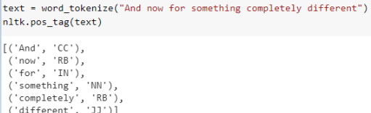
POS Tagging
Part of speech (POS) Tagging is a process to mark up the words in text format for a particular part of a speech based on its definition and context.
It is also called grammatical tagging

Slide 22
Session 1: Text Pre-Processing
Text Representation

Slide 23
Text Representation
The process of converting textual data into numerical formats so that machine learning algorithms can process and analyze the text
One-Hot Encoding:
Bag-of-Words (BoW):
TF-IDF (Term Frequency-Inverse Document Frequency):
Word Embeddings:
.

Slide 24
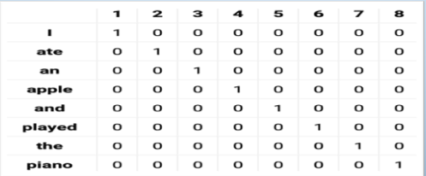
Text Representation
One-Hot Encoding:
Each word is represented by a binary vector with one '1' at the index corresponding to that word in the vocabulary and '0's elsewhere.
.

Slide 25
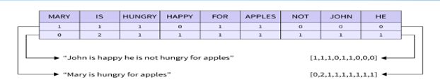
Text Representation
Bag-of-Words (BoW):
Represents a document by counting the frequency of each word, disregarding grammar and word order.
.

Slide 26
Text Representation
TF-IDF (Term Frequency-Inverse Document Frequency):
Weighs word frequency by the rarity of the word across all documents, emphasizing important words.
.

Slide 27
Text Representation
Word Embeddings:
Maps words to dense vectors in a continuous vector space (e.g., Word2Vec, GloVe).
.

Slide 28
Session 2: Image Pre-processing
What is a Digital Image?

Slide 29
What is a Digital Image?
A digital image is a grid of tiny elements called pixels. Each pixel contains information about color and brightness.
Pixels: Building blocks of an image.
Resolution: The number of pixels (width × height).
Color Depth: How many colors each pixel can represent.
Purpose:
Raw images can be imperfect or noisy. Preprocessing helps improve quality and extracts important features.

Slide 30
Session 2: Image Pre-processing
Basic Image Operations

Slide 31
Basic Image Operations
Grayscale Conversion:
Converts color images to shades of gray to simplify further processing.
Resizing :
Resizing: Adjust image dimensions.
Cropping:
Remove unwanted areas to focus on regions of interest.
Rotation:
Correct or adjust image orientation.
Visual Comparison:
Display before-and-after images to illustrate these operations.

Slide 32
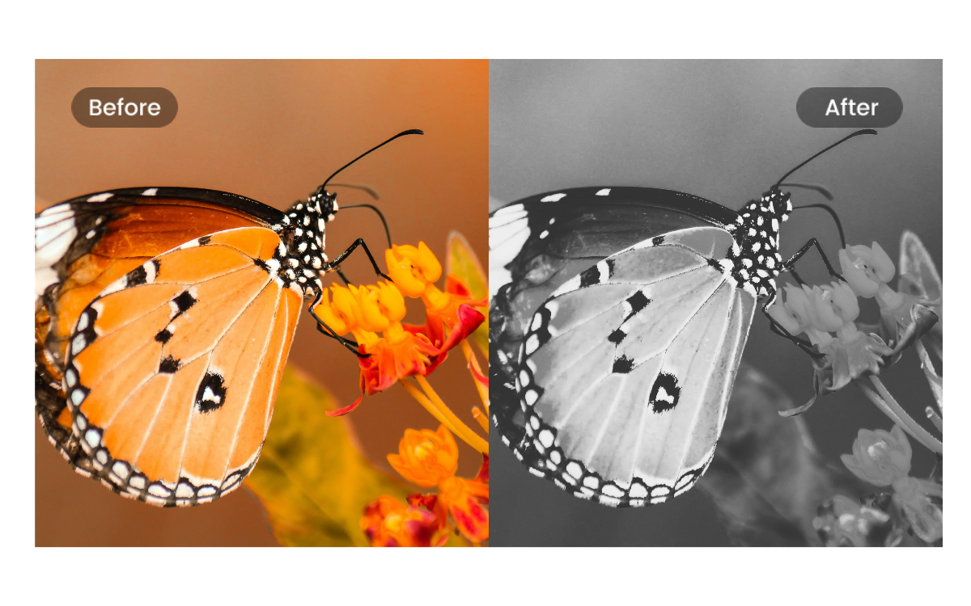
Basic Image Operations
Grayscale Conversion:

Slide 33
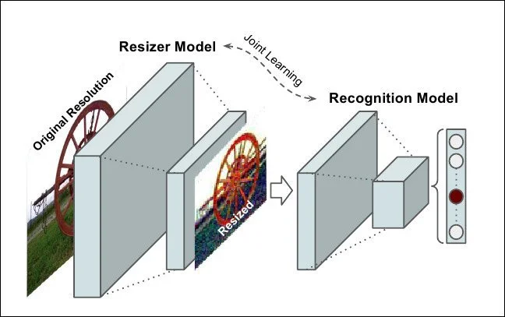
Basic Image Operations
Resizing :

Slide 34
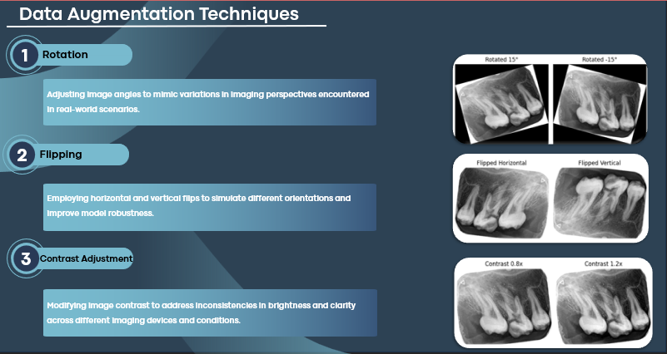
Basic Image Operations

Slide 35
Session 2: Image Pre-processing
Convolution 2D (Conv2D)

Slide 36
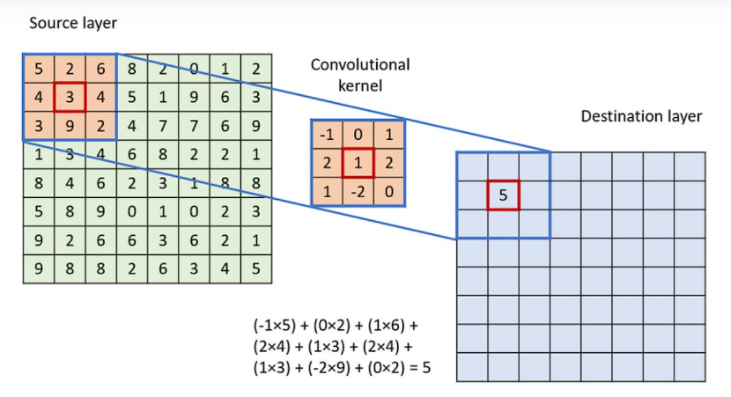
Convolution 2D :

Slide 37
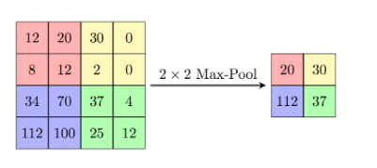
Max Pooling:
:

Slide 38
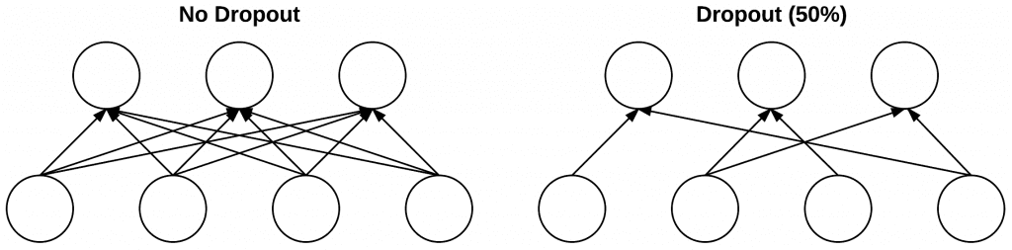
Dropout
Dropout is actually a form of regularization that aims to help prevent overfitting by increasing testing accuracy, perhaps at the expense of training accuracy.
For each mini-batch in our training set, dropout layers, with probability p, randomly disconnect inputs from the preceding layer to the next layer in the network architecture.

Slide 39
Session 2: Image Pre-processing
Edge Detection

Slide 40
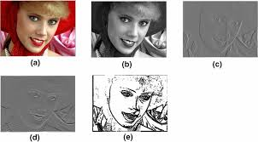
Edge Detection
Edges define the boundaries of objects by highlighting sharp changes in pixel intensity.
Techniques:
Gradient Operators (Sobel, Prewitt): Compute gradients in the image.
Canny Edge Detector: A multi-stage algorithm that provides robust edge detection.

Slide 41
Session 2: Image Pre-processing
Image Segmentation

Slide 42
Image Segmentation
The process of partitioning an image into meaningful regions or segments.
Why Segment?
To isolate objects or regions for further analysis (e.g., separating a foreground object from the background).
Common Methods:
Thresholding: Dividing pixels based on intensity values.
Clustering (e.g., K-means): Grouping pixels with similar characteristics

Slide 43
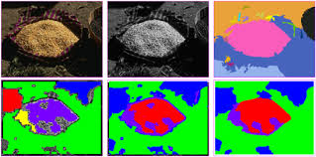
Image Segmentation

Slide 44
Any question

Slide 45
Thank you

